Slide 1


SMS SPAM CLASSIFICATION
PRESENTED BY:- ANIKET KUMAR SINGH (19CS04)

Slide 2
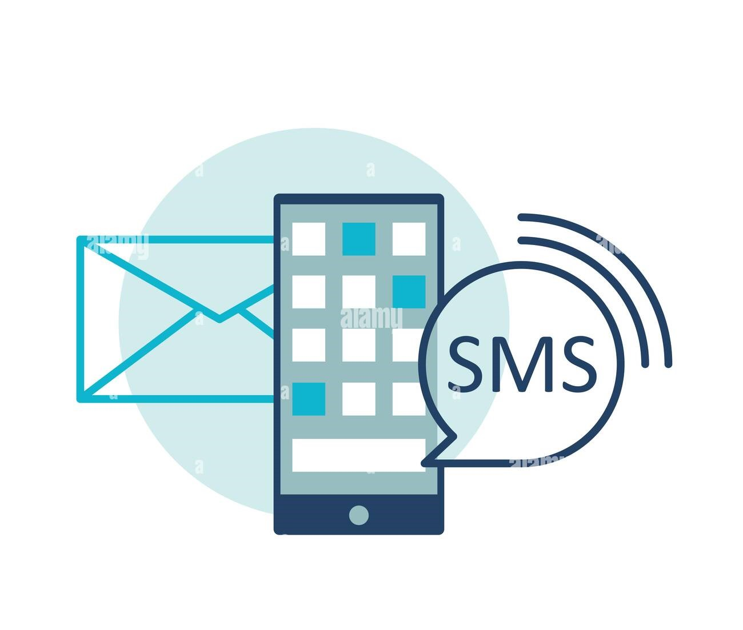
INTRODUCTION
SPAM is the virus infected SMS which results malfunctioning of mobile. HAM is basics a virus free SMS. SPAM SMS can corrupt the operating system of the mobile.

Slide 3

WHAT IS SMS SPAM ?
SMS Spam is any junk message delivered to a mobile phone as text messaging through the Short Message Service (SMS). These messages often uses promise of free gifts or product offers to make you reveal your personal information.

Slide 4
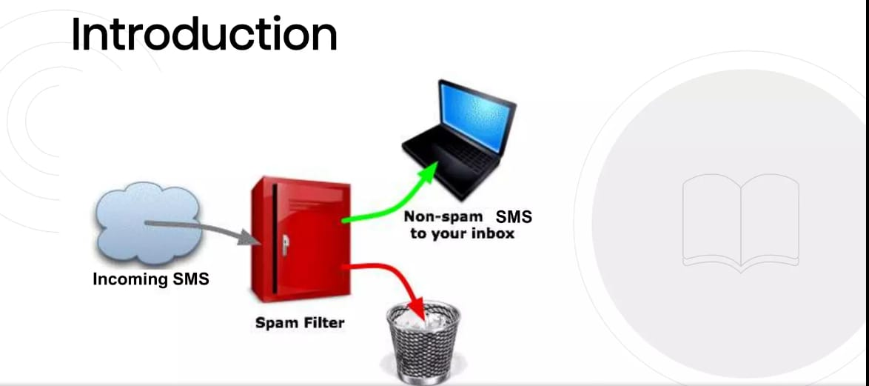

Slide 5
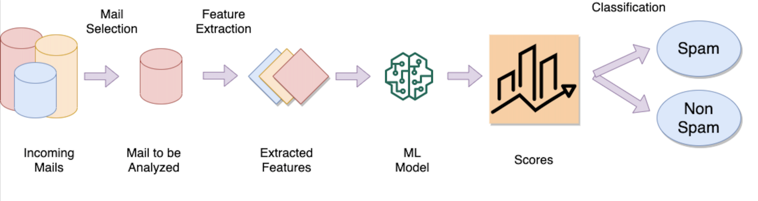
WORKING SPAM MAIL CLASSIFICATION

Slide 6
How the project is made?
The whole project is based on python programming language.
It uses some useful libraries of python such as sklearn and nltk.
Scikit-learn or generally sklearn is used for feature extraction process and model building.
Feature extraction ---> CountVectorizer and TfidfVectorizer
NLTK or natural language toolkit is used for text preprocessing of the messages.
Tokenization
Stemming
And finally the model is deployed on Heroku.

Slide 7
Algorithms & Libraries
Natural language processing (NLP) is a branch of artificial intelligence that helps computers understand, interpret and manipulate human language.
We will use algorithms such as :-
Multinomial Naive Bayes Classifier
Support Vector Machine etc.
We will use python libraries like:-
NLTK (Natural Language Toolkit)
Scikit-Learn
Pandas

Slide 8
PROCESSES IN SMS SPAM CLASSIFICATION
Data Cleaning
Exploratory Data Analysis(EDA)
Data Preprocessing
Model Building
Model Evaluation
Improvement
Website
Deployment

Slide 9
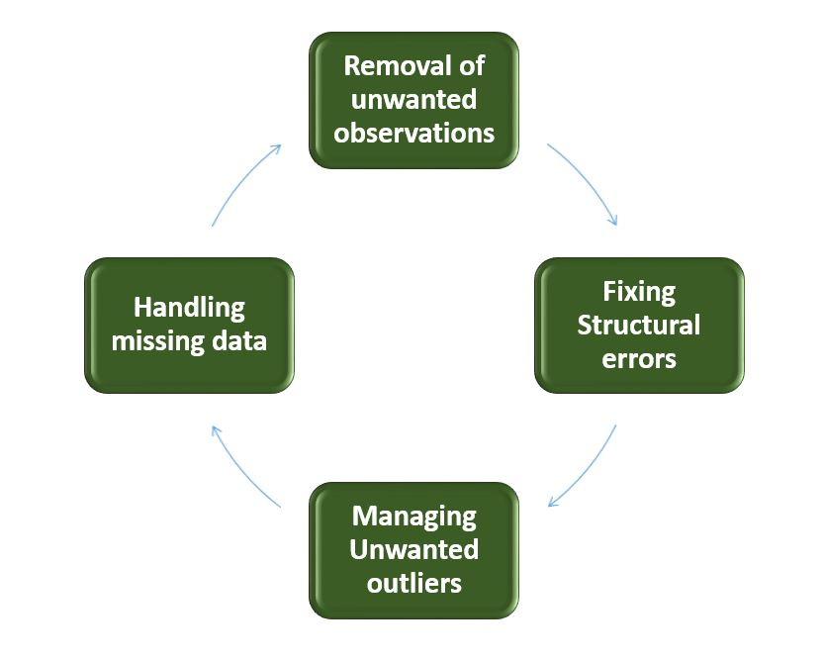
DATA CLEANING
Data cleaning is the process of preparing data for analysis by removing or modifying data that is incorrect, incomplete, irrelevant, duplicated, or improperly formatted.
Data cleaning is a lot of muscle work. There’s a reason data cleaning is the most important step if you want to create a data-culture, let alone make airtight predictions. It involves:
Fixing spelling and syntax errors
Standardizing data sets
Correcting mistakes such as empty fields
Identifying duplicate data points

Slide 10
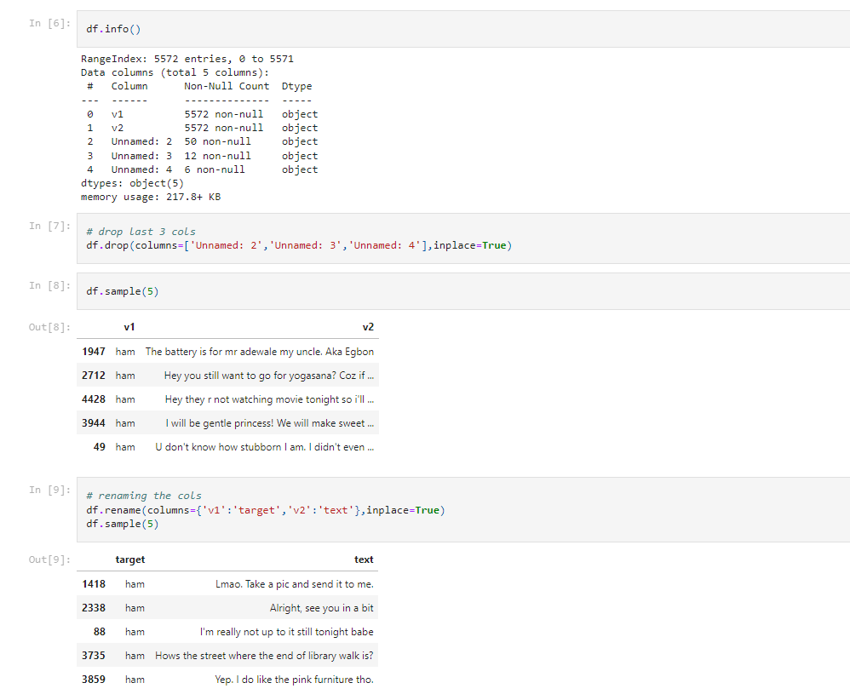
DATA CLEANING

Slide 11
EDA
Exploratory Data Analysis is an essential step for understanding the data that we are working on it helps us in identifying any hidden pattern in the data, the correlation between different columns of the data, and analyzing the properties of the data.
EDA generally takes around 30% of the total project time because we need to write a lot of code in order to create different types of visualizations and analyze them.

Slide 12
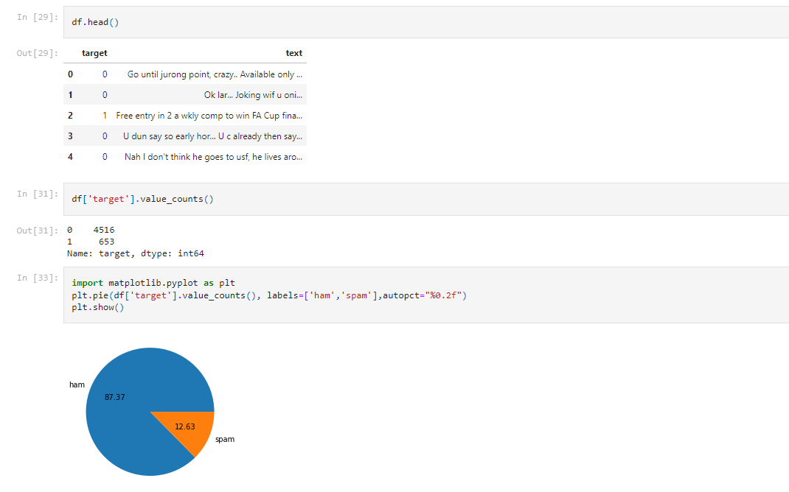
EDA

Slide 13
Data Preprocessing – Data Preprocessing is a technique that is used to convert the raw data into a clean data set.
Model Building – In this, for training a model we initially split the model into 3 three sections which are 'Training data', 'Validation data' and 'Testing data'.
Model Evaluation – Model evaluation is the process of using different evaluation metrics to understand a machine learning model's performance, as well as its strengths and weaknesses.
Deployment – Machine learning model deployment is the process of placing a finished machine learning model into a live environment where it can be used for its intended purpose.

Slide 14
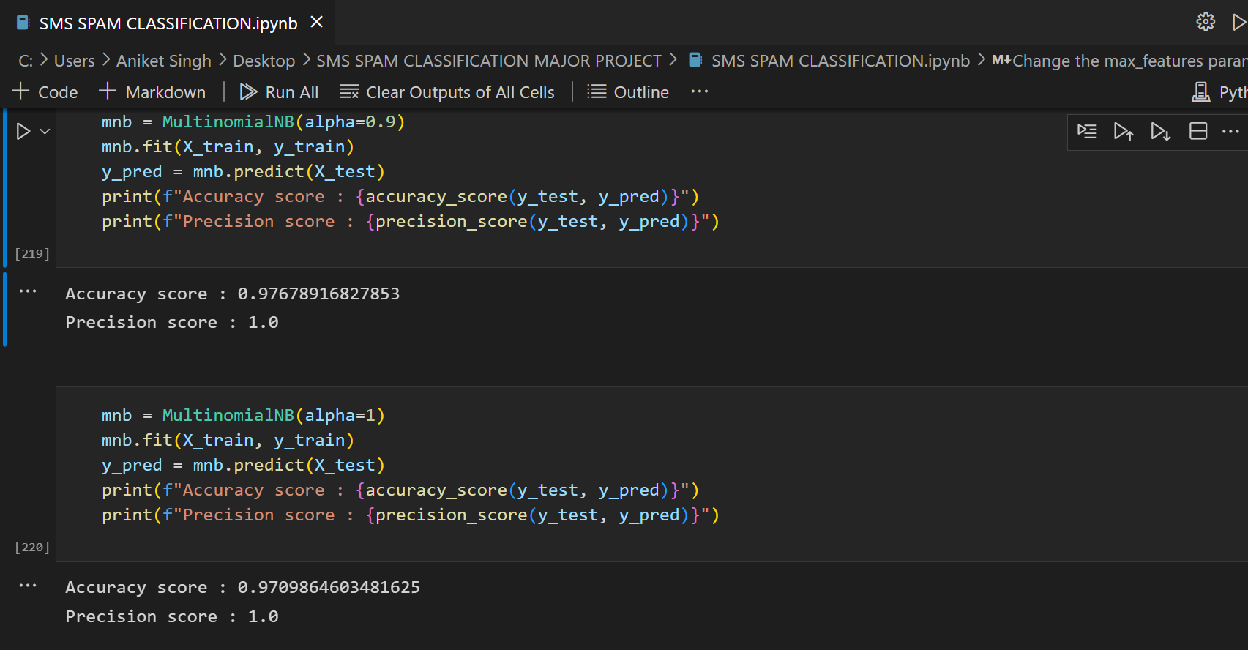
Model Performance

Slide 15
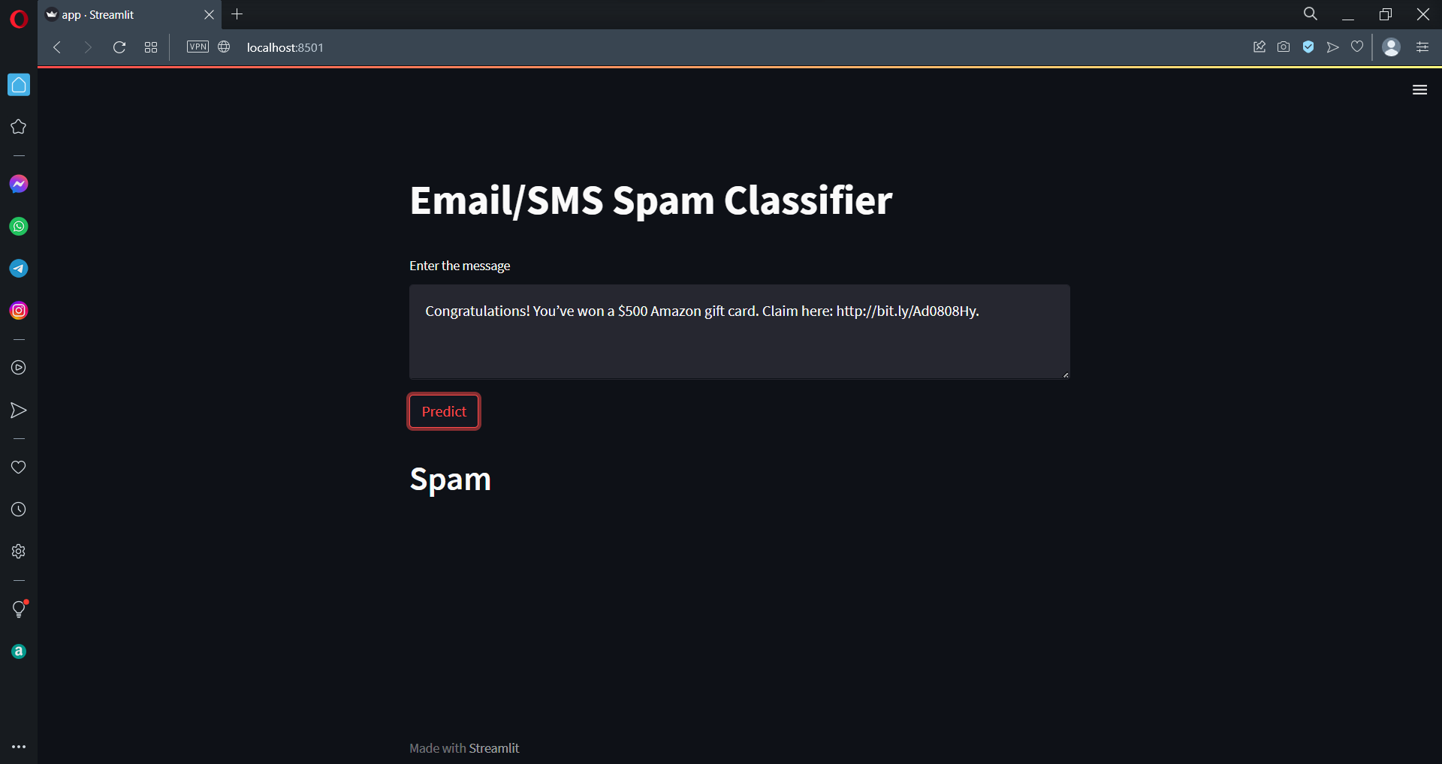
Prediction:-

Slide 16
BENEFITS
SMS spam classifier can classify messages as spam and not spam.
It can also classifies our mails that we have received as spam and not spam.
Good Efficiency
Greater accuracy
Spam filters save time that you could have wasted on removing spam from your Inbox.
The previously reported spam messages will no longer hit your Inbox.
Spam classifier can be used for sms and emails also.
It can easily classify spam and non-spam messages.

Slide 17
THANK YOU

